Slide 1
Constant and Operator Recognition in Expressions
Group Members Name:
Nur A Khadija Khandaker Piya (222400003)
Mst Monira Khatun (222400019)
Jannatul Firdous Samiya (222400024)
Course Code: CSE-414
Course Title: Compiler Design Lab

Slide 2
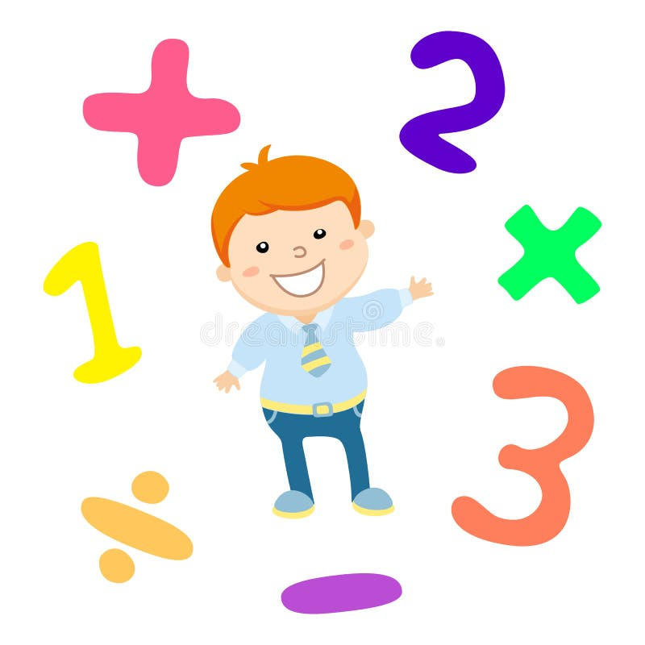
Introduction
Expressions are a mix of values, variables, and symbols that tell us what calculation or action to perform.
For example, in the expression 3 + 5, 3 and 5 are constants (fixed values),
and + is an operator (symbol for addition).
Recognizing these constants and operators is important in programming
because it helps computers understand and process instructions correctly.
This task is especially important when creating tools like compilers or interpreters that analyze code.

Slide 3

Problem Statement
When we look at expressions, it can be tricky to figure out which parts are constants and which are operators. Some challenges include:
Recognizing constants: A constant is a fixed value like numbers (e.g., 42) or predefined symbols (e.g., pi).
Recognizing operators: Operators like +, -, *, or / may appear in different contexts.Some operators look similar to symbols used for other purposes.
Complex expressions: In longer expressions like a * (b + c) / d, distinguishing between constants,
operators, and variables can get complicated.These challenges need a clear method to
analyze expressions correctly.

Slide 4

Solution
To recognize constants and operators in an expression, we can use a step-by-step approach:
Break the Expression into Parts (Tokenization): Divide the expression into smaller pieces, called tokens. For example:
Expression: 3 + a * 5
Tokens: 3, +, a, *, 5

Slide 5
Solution
Use Simple Rules:
If a token is a number (e.g., 5, 100), it’s a constant.
If a token matches known operator symbols (+, -, *, /), it’s an operator.
If a token doesn’t match these, it’s something else (like a variable).

Slide 6
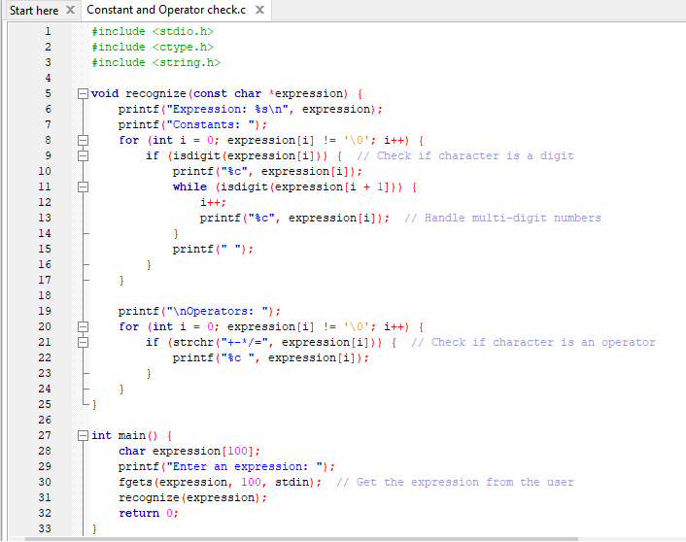
C Program

Slide 7
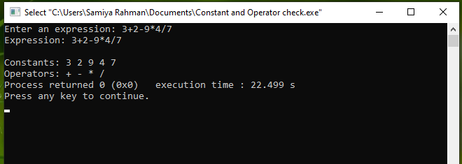
Output

Slide 8
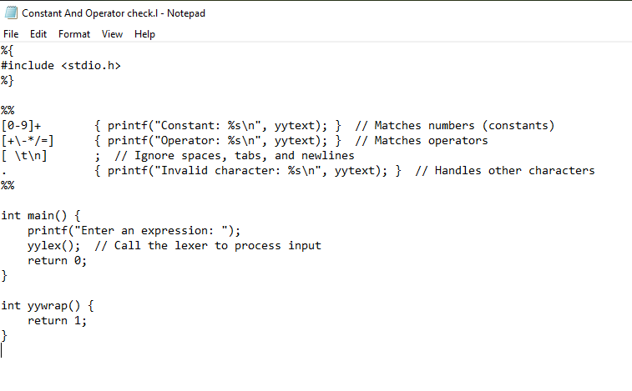
Lexical Program

Slide 9
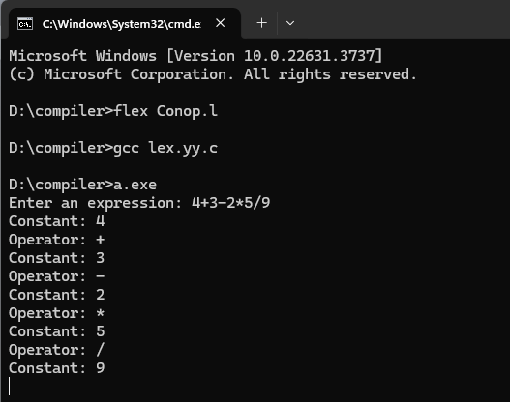
Output

Slide 10

Discussion
This method makes recognizing constants and operators easy:
Accuracy: By defining simple rules, we can easily tell the difference between constants and operators.
Flexibility: This method works for simple expressions and can be expanded to handle complex cases.
Challenges:
Special symbols (e.g., ^ for power) might require extra rules.
Expressions with unusual formats may need more advanced techniques.
By improving the basic rules and automating the process, we can handle
a wide variety of expressions.

Slide 11
Conclusion
Recognizing constants and operators in expressions is an important step in programming and computing. Using simple rules and automation, we can break down expressions into their parts and understand them better. This process is a key part of creating tools like compilers, calculators, and software applications that work with expressions. With practice, we can handle even complex expressions effectively and accurately.

Slide 12


